Slide 1

Myntra Analysis
suparna

Slide 2
Introduction to Myntra
1. Overview (Brief Description)
Founded in 2007, pivoted to fashion in 2011.
Leading fashion & lifestyle e-commerce in India.
2. Key Features
Wide Range of fashion, beauty, and lifestyle products.
Exclusive Brands: HRX, Roadster, House of Pataudi.
Celebrity Partnerships: Exclusive collaborations.
3. Acquisition by Flipkart
Acquired by Flipkart in 2014; operates as a separate entity.
4. Innovations & Loyalty
Myntra Insider: Loyalty program.
Myntra Studio: Personalized fashion content.
5. Major Events
End of Reason Sale (EORS): Biggest sales event with huge discounts.

Slide 3
Myntra Business Model
1. Marketplace Model
Platform for third-party sellers
Commission-based revenue
2. Private Labels
Exclusive brands: HRX, Roadster, House of Pataudi
Higher margins on in-house products
3. Exclusive Collaborations
Brand & Celebrity partnerships for unique collections
4. Sales Events
EORS & Flash Sales drive high-volume sales
Time-limited discounts to boost demand
5. Loyalty Program
Myntra Insider: personalized offers & early access to sales
6. Tech & Logistics
Data-driven personalization & fast deliveries with Myntra Logistics
7. Revenue Streams
Commission, private label sales, advertising, logistics fees

Slide 4

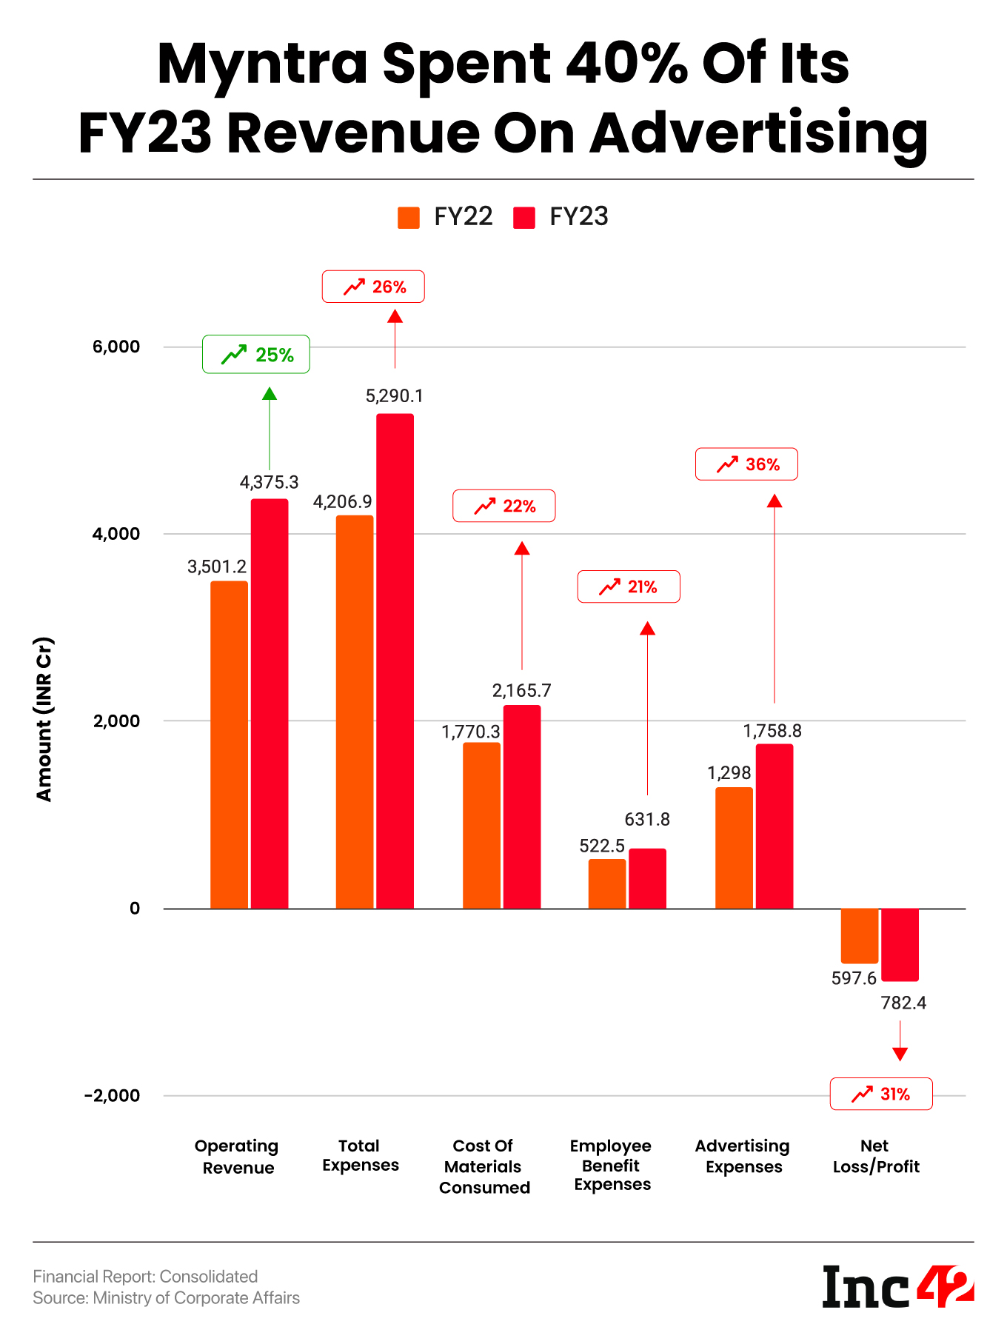
Chart for Myntra's Market Position & Growth
Myntra's revenue and expenses both increased in FY23, with a significant rise in advertising expenses (40% of revenue). Despite revenue growth, the company reported a larger net loss.
This chart provides a clear financial snapshot of Myntra’s cost structure and highlights the growing importance of advertising investments in driving revenue, despite profitability challenges.

Slide 5
Membership and Marketplace Revenue
1. Myntra Insider (Membership Program)
Points & Rewards:
Earn Insider points for every purchase.
Exclusive Access:
Early access to sales and special offers.
Tiered System:
(Insider, Elite, Icon) - more benefits as you move up.
Partnerships:
Points redeemable with Zomato, Gaana, and more.
Revenue Impact:
Higher Retention & Repeat Purchases.
Increased Average Order Value (AOV).
2. Marketplace Revenue
Commission from Sellers:
Percentage varies by category (10-30%).
Logistics & Delivery:
Fees for warehousing, shipping, and order fulfillment.
Advertisement Revenue:
Sponsored listings and banner ads from brands.
Private Labels:
Higher margins from own brands like HRX, Roadster.

Slide 6
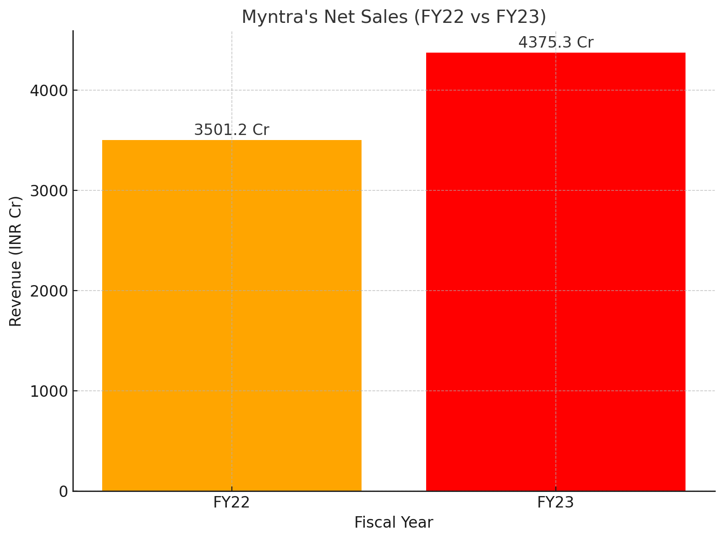
Ecommerce and net Sales
1. E-commerce Sales
Leading fashion platform in India.
Major drivers: EORS, Mobile app (85% orders via app).
Wide range: Fashion, accessories, beauty, home decor.
2. Net Sales
FY23 revenue: ₹4,375.3 Cr (+25% YoY).
Key contributors: Private labels, third-party sellers, and Myntra Insider program.
Growth: Tier 2/3 expansion and product diversification.

Slide 7
Comparable online stores of Myntra.com

Slide 8
Technology Utilization
Myntra's Technology Utilization
1. Personalization
AI Tools: My Fashion GPT & My Stylist for tailored outfit suggestions.
2. Augmented Reality (AR)
Virtual Try-On: See how clothes fit before buying.
3. Enhanced Search
Vernacular Search: Supports multiple regional languages.
4. Cloud Computing
Microsoft Azure: Scalable operations during peak times.
5. Data Analytics
Machine Learning: Analyzes customer behavior for better marketing.
6. Omnichannel Experience
Store Integration: Fast delivery from nearby stores.

Slide 9
Data Analytics and Personalization
🌟 Data Analytics & Personalization at Myntra 🌟
📊 Data Analytics
Centralized Platform: Utilizes Microsoft Azure for comprehensive insights.
Real-Time Insights: Power BI for quick, actionable data.
Smart Search: Photo Search matches user images with products.
🎯 Personalization Strategies
AI-Powered Recommendations: My Fashion GPT & My Stylist for personalized outfit suggestions.
Virtual Try-On: Experience products with AR technology.
Tailored Shopping Experience: Customized product displays based on user behavior.
Omnichannel Convenience: Fast delivery from nearby stores.
🚀 Why It Matters
Enhances customer engagement and satisfaction.
Drives higher conversion rates and loyalty.

Slide 10
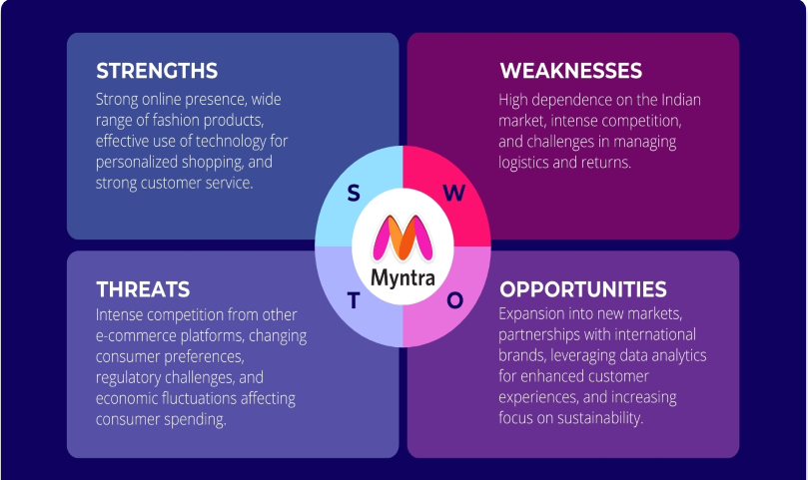
SWOT Analysis of Myntra.com

Slide 11
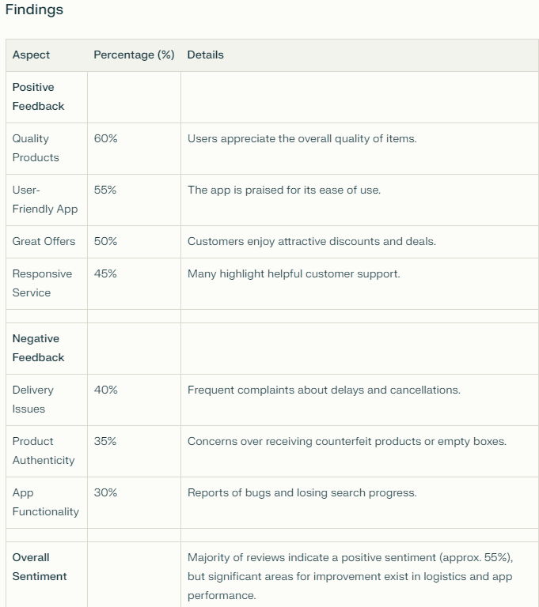
Customer Review Analysis
Myntra is generally well-regarded, with around 55% positive sentiment, but addressing delivery challenges (40%) and enhancing app functionality (30%) are crucial for improving overall customer satisfaction.

Slide 12
Myntra Customer Review Analysis: High and Low Impact Comments

Slide 13
Myntra Customer Review Analysis: High and Low Impact Comments
High Impact Consumer Comments
Quality: "Great quality and variety of products!"
User Experience: "User-friendly app, easy to navigate."
Customer Service: "Responsive support helped me quickly."
Brand Loyalty: "Myntra is my go-to for fashion!"
Virtual Try-On: "The virtual try-on feature is fantastic!"
Low Impact Consumer Comments
Delivery Issues: "I received an empty box for my order. Very disappointing!"
"Delivery was delayed multiple times."
Product Authenticity Concerns: "I got a product that seemed fake and without tags."
"Some items don't match the quality shown online."
App Functionality Problems: "The app crashes often."
"Payment processing issues during checkout."

Slide 14
Customer Sentiment Overview
Data Source: Collected customer reviews from Myntra website and social media.
Sentiment Categories: Reviews categorized as:
Positive: 60%
Neutral: 20%
Negative: 20%
Visual: Simple pie chart showing:
Positive (Green) - 60%
Neutral (Gray) - 20%
Negative (Red) - 20%

Slide 15
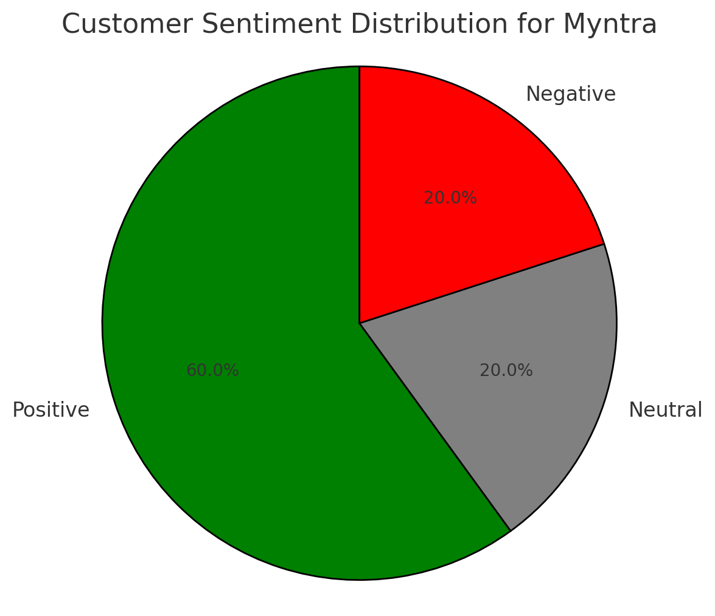
Pie chart showing Customer Sentiment Distribution for Myntra

Slide 16
Market Trend Overview
Popular Categories: Rise in casual wear, athleisure, and ethnic wear.
Consumer Shift: Growing interest in sustainable fashion and comfort wear.
Seasonal Peaks: High sales during festivals like Diwali and year-end sales.
Technology Trends: Increased use of mobile app shopping and personalized recommendations.

Slide 17
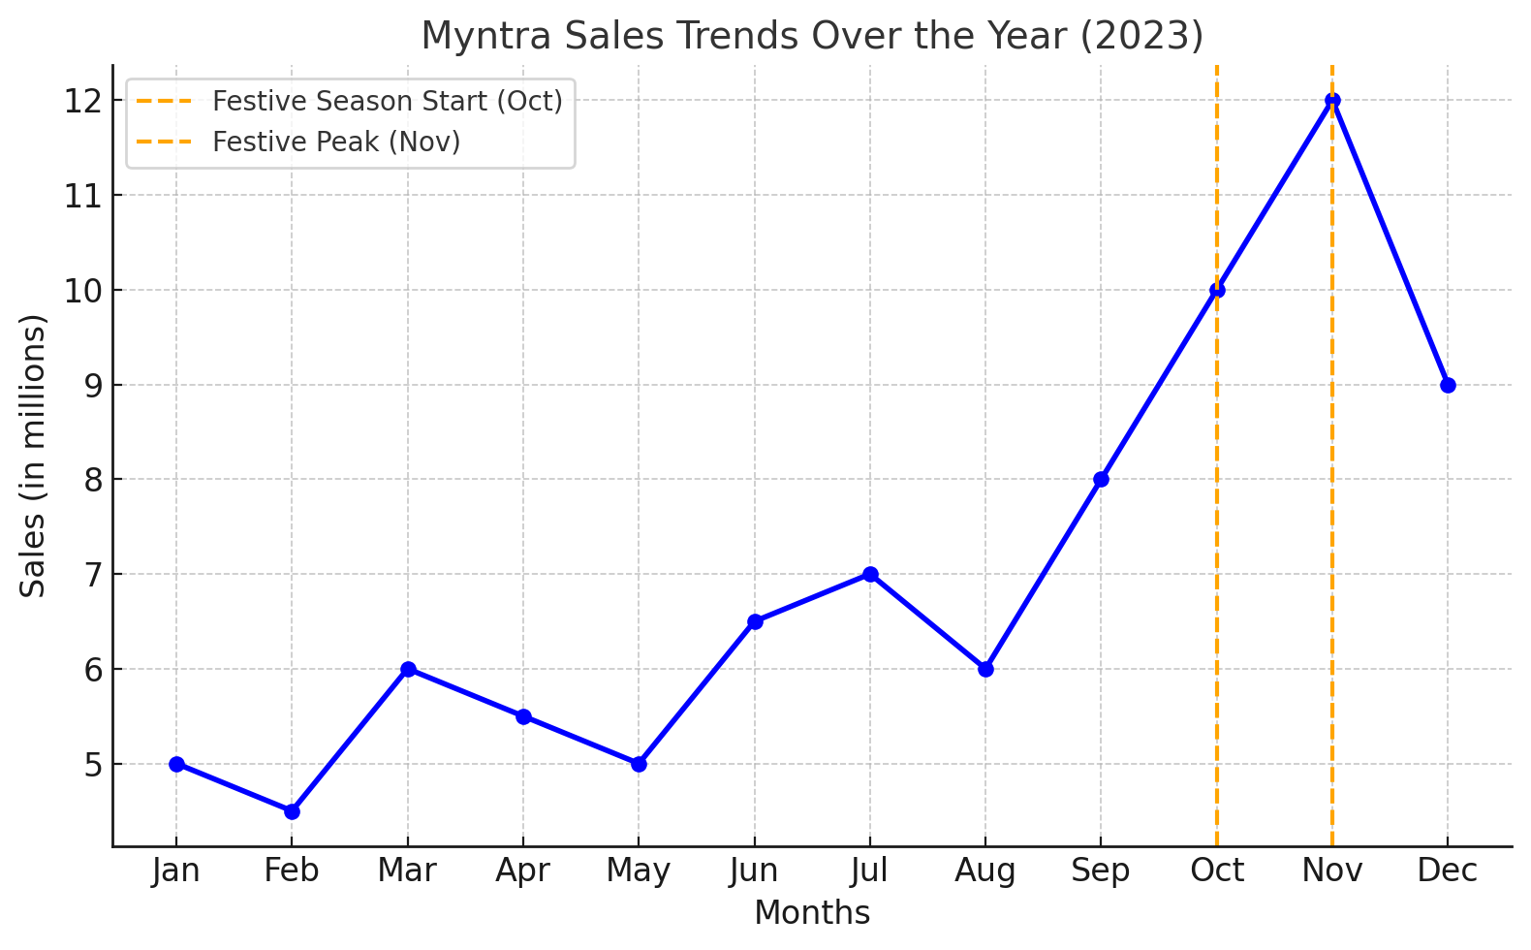
Myntra sales trends Over the Year(2023)

Slide 18
Key Trends and Recommendations
Mobile Shopping Growth: Consumers are using the Myntra app more frequently.
Influencer Impact: Fashion influencers are driving interest in trending collections.
Price Sensitivity: Consumers are looking for good deals and discounts.
Recommendations:
Expand sustainable and comfortable fashion categories.
Invest in personalized shopping experiences and mobile-first strategies.

Slide 19
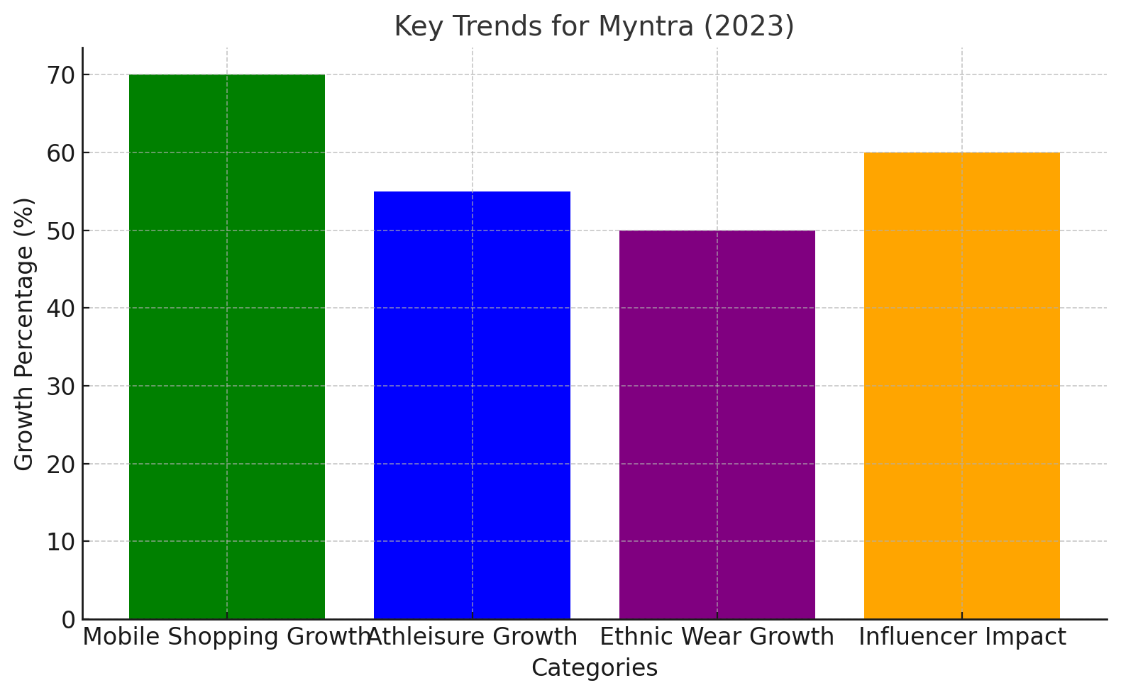
A bar diagram for Key trends

Slide 20
Formulating Strategic Recommendations for Myntra
Formulating Strategic Recommendations for Myntra
Based on the analysis of customer sentiment, market trends, and competitor comparison, here are strategic recommendations for Myntra:
Strategic Recommendations Overview
Influencer Marketing & Customer Concerns
Expected Outcomes

Slide 21
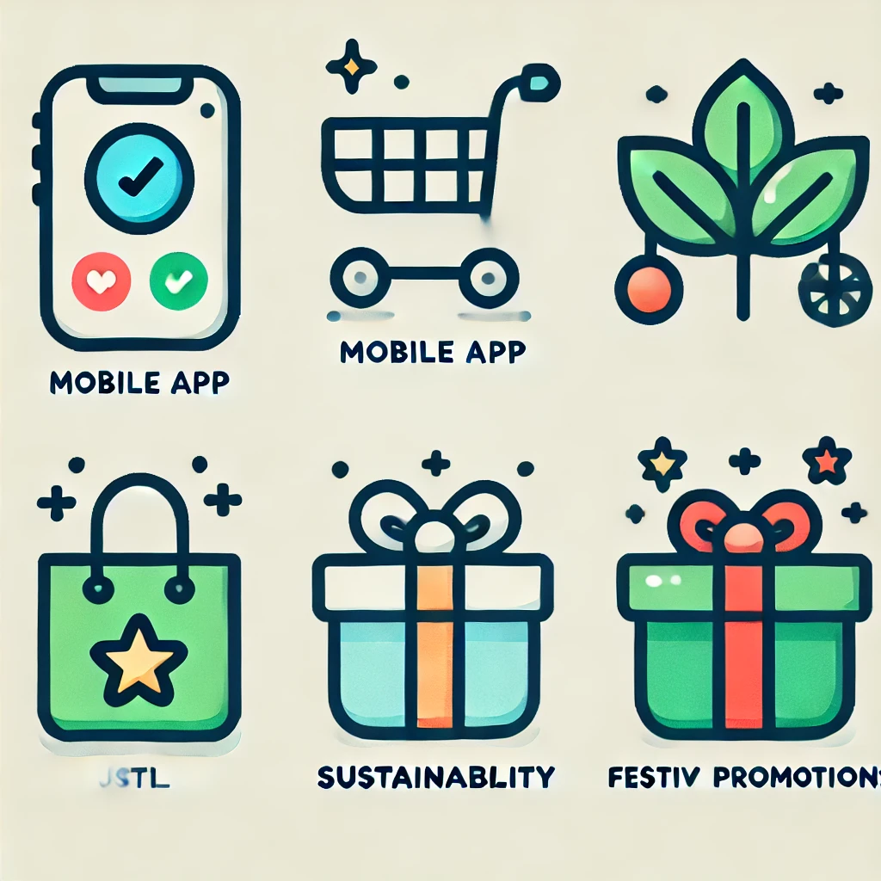
Strategic Recommendations Overview
Mobile-First Strategy: Enhance app experience and offer app-exclusive deals.
Sustainable Fashion: Expand eco-friendly product lines and promote comfort wear.
Capitalize on Seasonal Trends: Boost marketing during peak festive seasons.

Slide 22
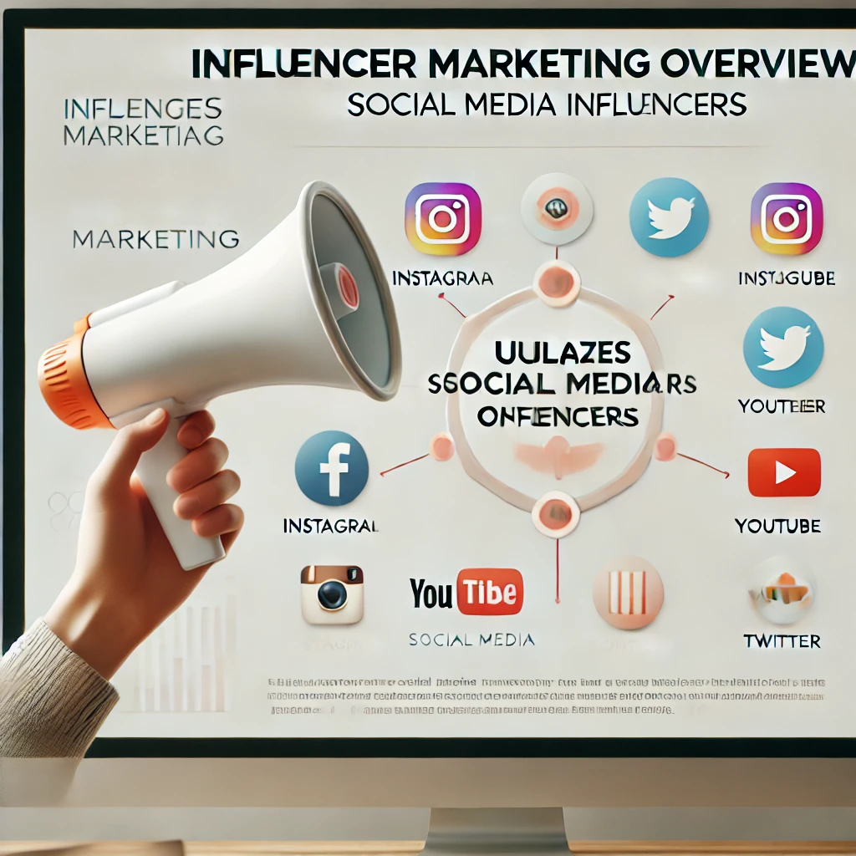
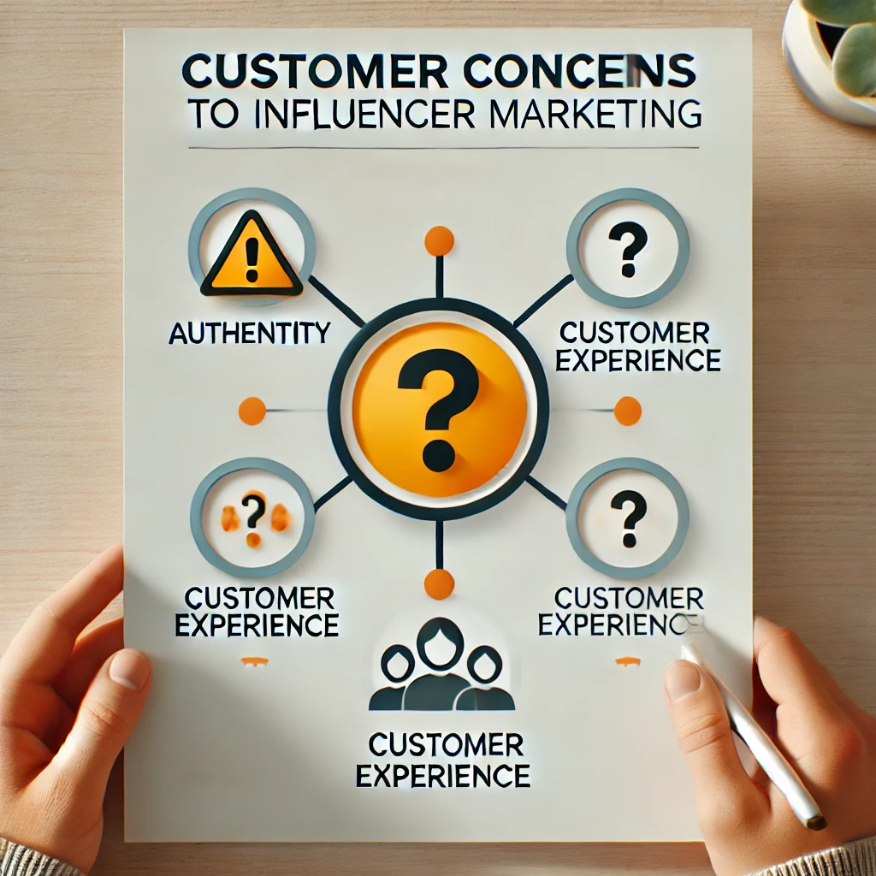
Influencer Marketing & Customer Concerns
Influencers:
Icon of a person with a megaphone or camera (symbolizing content creation and promotion).
Social media icons (Instagram, YouTube, Twitter) representing the platforms influencers use.
A group of people (symbolizing reach and audience).
Customer Engagement:
A speech bubble icon (indicating communication and engagement).
Thumbs-up or heart icons (symbolizing likes or positive feedback).
A shopping bag (representing product recommendations leading to sales).
Transparency and Trust:
A checkmark or shield icon (representing trustworthiness).
A magnifying glass (symbolizing clarity and transparency).
Stars or ratings (indicating customer feedback).
Concerns:
An exclamation mark or warning icon (highlighting potential issues like trust or authenticity).
A question mark (symbolizing customer doubts or queries).

Slide 23
Market Trends Identification for Myntra
Market Trend Identification is Understanding Fashion Trends for Myntra
Data Collection
Monitor social media conversations
Analyze influencer content
Trend Analysis
Track popular hashtags
Perform sentiment analysis
Report Findings
Visual Representation
Actional Insights

Slide 24
Strategic Recommendations
1. Enhance Customer Experience
🔄 Improve Return Policy: Simplify exchanges and refunds.
👩‍💼 Customer Support: Train staff for better service.
2. Leverage Technology
🤖 AI Personalization: Tailored recommendations.
🕶️ Augmented Reality: Expand virtual try-on features.
3. Diversify Marketing Channels
🤝 Influencer Partnerships: Collaborate with micro-influencers.
📚 Content Marketing: Create engaging fashion content.
4. Focus on Sustainability
🌱 Sustainable Products: Increase eco-friendly options.
🔍 Transparency: Communicate sourcing practices.
5. Expand Product Range
🛍️ Private Label Strategy: Grow premium offerings.
🎉 Seasonal Collections: Launch limited-edition items.
6. Optimize Digital Presence
🔍 SEO Improvements: Enhance search visibility.
📱 Mobile Optimization: Ensure seamless mobile experience.
7. Community Engagement
🎥 Interactive Campaigns: Host live shopping events.
💬 Feedback Mechanism: Implement robust customer feedback systems.
Conclusion
implementing these strategies, Myntra can strengthen its market position and enhance customer loyalty in the competitive fashion e-commerce landscape.

Slide 25
THANK YOU

